Slide 1
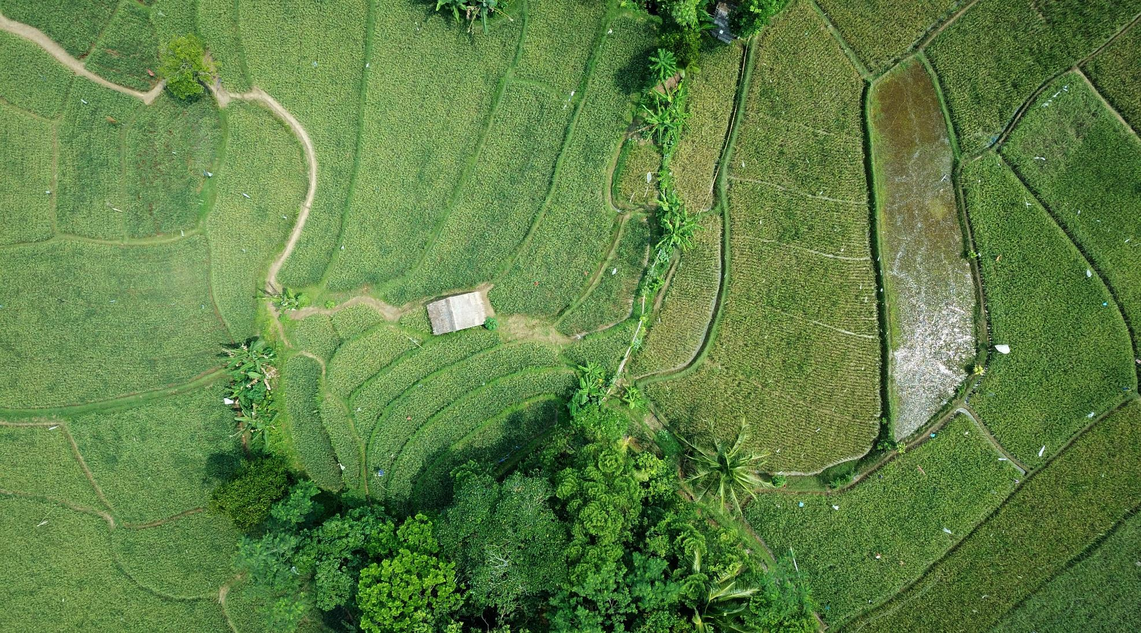
BINGO - the game with online interface.
Developed by:-
Saurabh Roy

Slide 2

About Bingo
Its Online Version
Recognise different players by their respective Ip addresses.
Fill the 5X5 tiles using random numbers for each player.
Red tile: stands for non-checked number.
Green tile: stands for checked number.
Bingo is a game of chance in which each player matches numbers printed in different arrangements on 5×5 cards which the numbers the game host (caller) draws at random, marking the selected numbers with tiles.

Slide 3




Features
Storage
For now, the file system interface
Instant Upgrade
Update after each checked tile.
No Access Anomaly
Others instead of recognized players could not enter.

Slide 4




Motivation
Self Interest
Need of Eco-friendly game
Connecting People

Slide 5




Programming info…

Slide 6
Programming info…
Front End
Back End
Storage
HTML
CSS
JS
PHP
File System

Slide 7

Rules of the game.
There would be 5 players playing game.
There will be 25X25 tiles for each players filled with numbers [1-25] in random order with all tiles red.
Players will play turn-by-turn.
In each turn player will select a number and all corresponding tiles for each user will be updated automatically.
The players with a whole green row or green column or green diagonal shall win.
Summary of rules at a glance.

Slide 8





Thank You
Saurabh Roy
8319366545
roysaurabh1308@gmail.com
bingo@000webhost.com

